Slide 1


Audiobook using Python
Done by:
Guide:

Slide 2


Introduction
Integrating novel technologies and their new capacities to increase educational productivity by considering individual differences in distance education are very essential phenomena in effective learning. To approach educational problems sensibly, contemporary education uses and integrates new technologies into distance education in many developed or developing countries.
Also, it provides diverse opportunities to people from different environments, different ages, all income rates and/or all vocational groups.
..Therefore, these people can obtain an equal opportunity without losing their productivity and arrange their own pace and capacity for education as well as benefit from communication technology.

Slide 3
Abstract
As a contemporary system to provide equal education rights to all learners, distance education gives different education opportunities to people who cannot get enough educational services because of the some limitations of traditional education.
Distance education at the Open Education System of Anadolu University has been formed for all diverse people who have severely different educational needs and expectations from each other.
Therefore, the system provides different educational programs and services to them, especially the people who need special education.

Slide 4
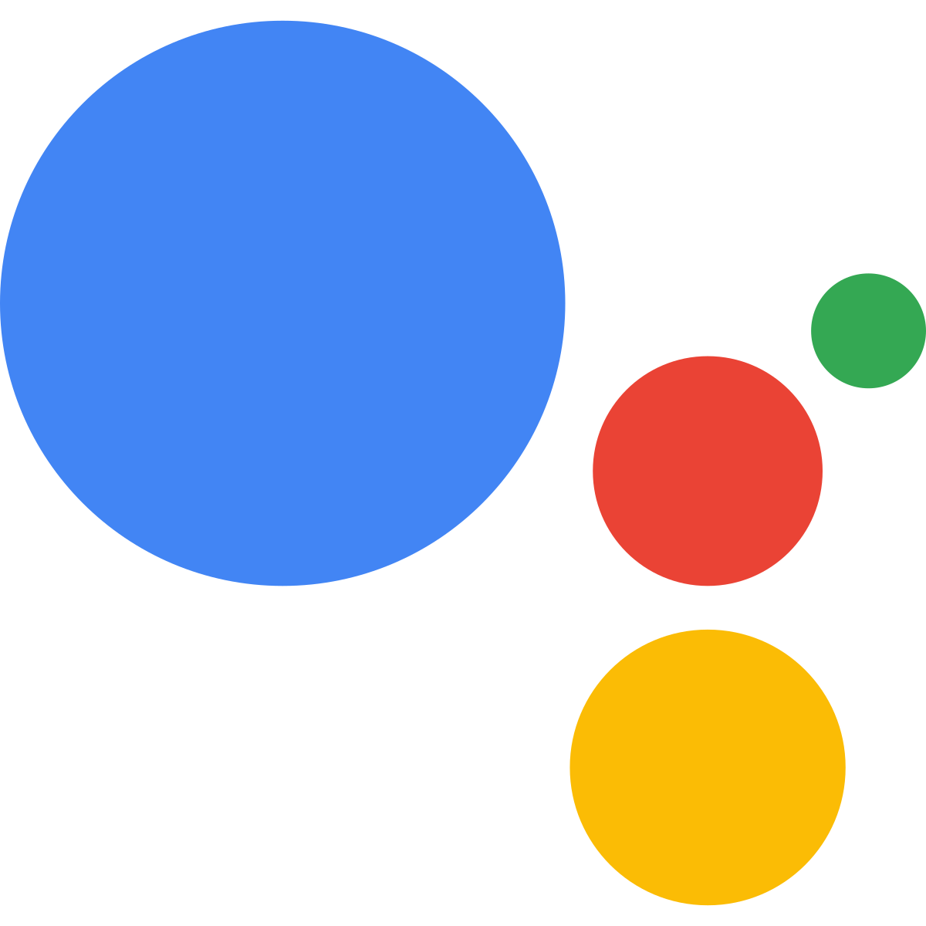
Existing Problem
Google Voice Assistant
Initial cost could outweigh savings. While it's possible to make both time and cash savings using these virtual assistant devices, they don't always come cheap.
Security could be an issue.
Voice recognition isn't perfect.
A microphone in your home.

Slide 5
Proposed Problems
We have proposed problem on this project is that, read the pdf or any other document by using PyPDF3 package in Python and pyttsx3 in Python
In Google assistant can’t read as file, we implemented a project on file read operation and then speak the content of the file into speech by pyttsx3.
We are overcome the disadvantage of the google by file reading then convert into as speech.

Slide 6
Block Diagram
Get a PDF File
Read The PDF file
Covert File Text to Speech

Slide 7
Advantages
Portable. You can listen to an audiobook anywhere using your smartphone. ...
Enjoy having a book read to you. Audiobooks have fantastic, expressive narrators!
Fit more reading into your schedule. ...
Multitask.
In the dark.
Learn a new language.
If holding a book is uncomfortable, listen to an audiobook.

Slide 8
Disadvantages
You'll miss the illustrations & graphics.
You may get the wrong tone for the narrators' voice.
Lack of imagination, as you won't take a break to think about on continuous reading.
Last but not least the smell of old or new papers of the books!

Slide 9
Application
Best audiobook apps in Google Play Store
Google Play Books. Google brought audiobooks to Play Store in January 2018.
Audible. If you have tried audiobooks and realized they are your thing, you should try Audible.
LibriVox.
Libby.
Audio Books.
Oodles.
Kobo.
Kindle for Android

Slide 10
Conclusion
How can E- Audio-Book Material be used?
E-audio-books are instruction materials that blind students can use in every situation and every time without
being tied to any place or without other people’s help. E-audio-books produced for blind students can create an
environment to provide, enrich, inform, guide and teach subjects completely by creating an environment to learn
and also develop independent learning skill to solve problems and answer question as well as discuss on different
course related topics. Then we have implemented a file content to speech will help the eye challenger people to learn and listen to this speech audio.

Slide 11
Thanking You!

